Slide 1
Medical Diagnostic Application
AED FINAL PROJECT
Techie Tribe
Nikita Ravindran – 001476962
Srikanth Reddy Gubballi - 001449665
Vishaka Varma - 001448330

Slide 2
Problem Statement
The constant need for diagnostic laboratories to improve quality and productivity while reducing turn-around-time, alongside constraints of personnel shortages implies that lab managers must constantly rethink the laboratory technology to optimize the laboratory organization and performance.
The development of a collaborative perspective towards collecting and documenting a history of medical reports and having them sent across different organizations for different purposes would help solve the constraints.

Slide 3
Objective
Our project aims to build a medical diagnostic application which documents the ongoing active patient’s medical records in addition to keeping a track and record of each patient’s previous medical test history across lab organizations. Thus, making it easy for the patients to access and share records via a single application to multiple hospitals/doctors/laboratories.

Slide 4
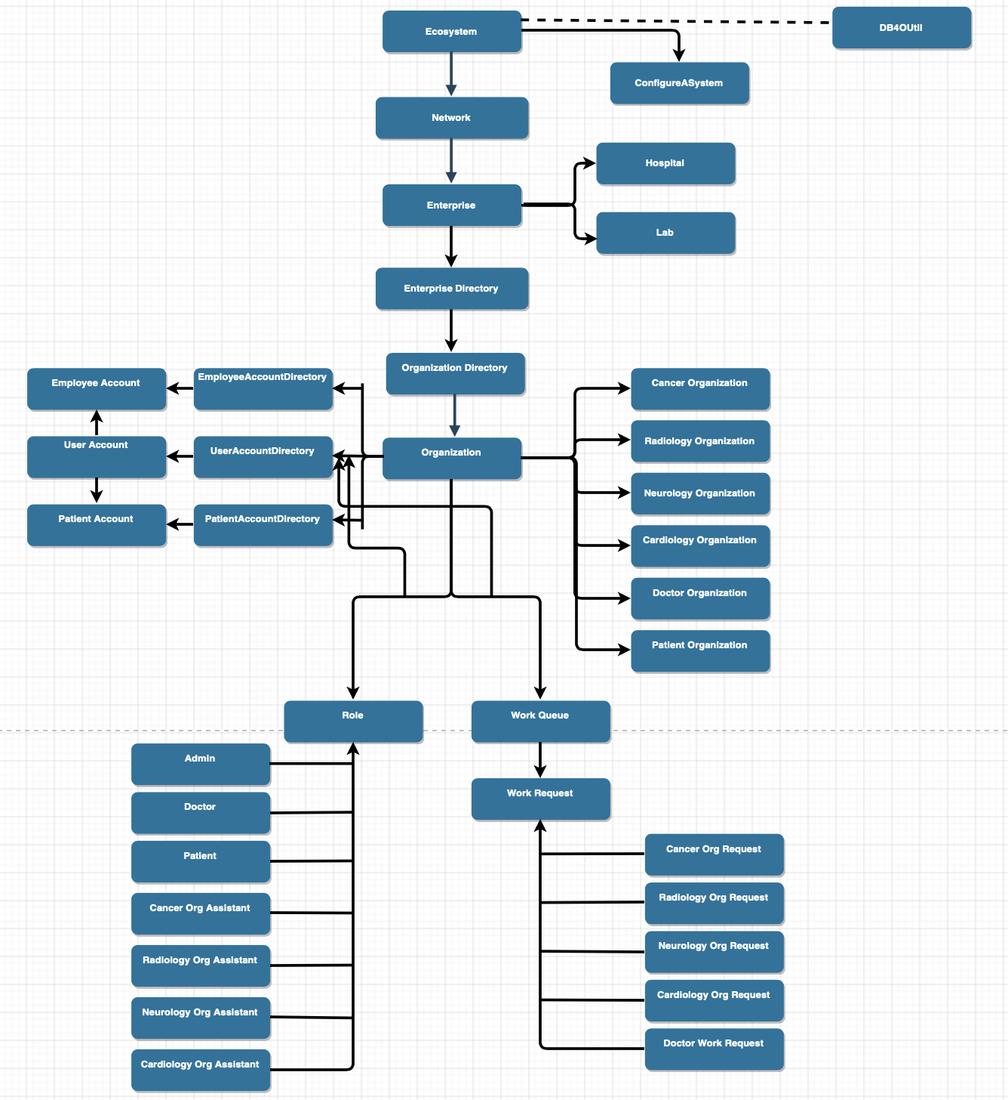
Object Model

Slide 5
Use Cases
Second Opinion for Doctors and Patients
Notifications between Lab and Patient
Analysis of lab reports using Graph
Enterprise and Organization communication
Patient can view all lab requests
Doctor can view all reports from various labs and patients under him. When a doctor logs into the app, he/she can see the patients under him/her and their requests

Slide 6
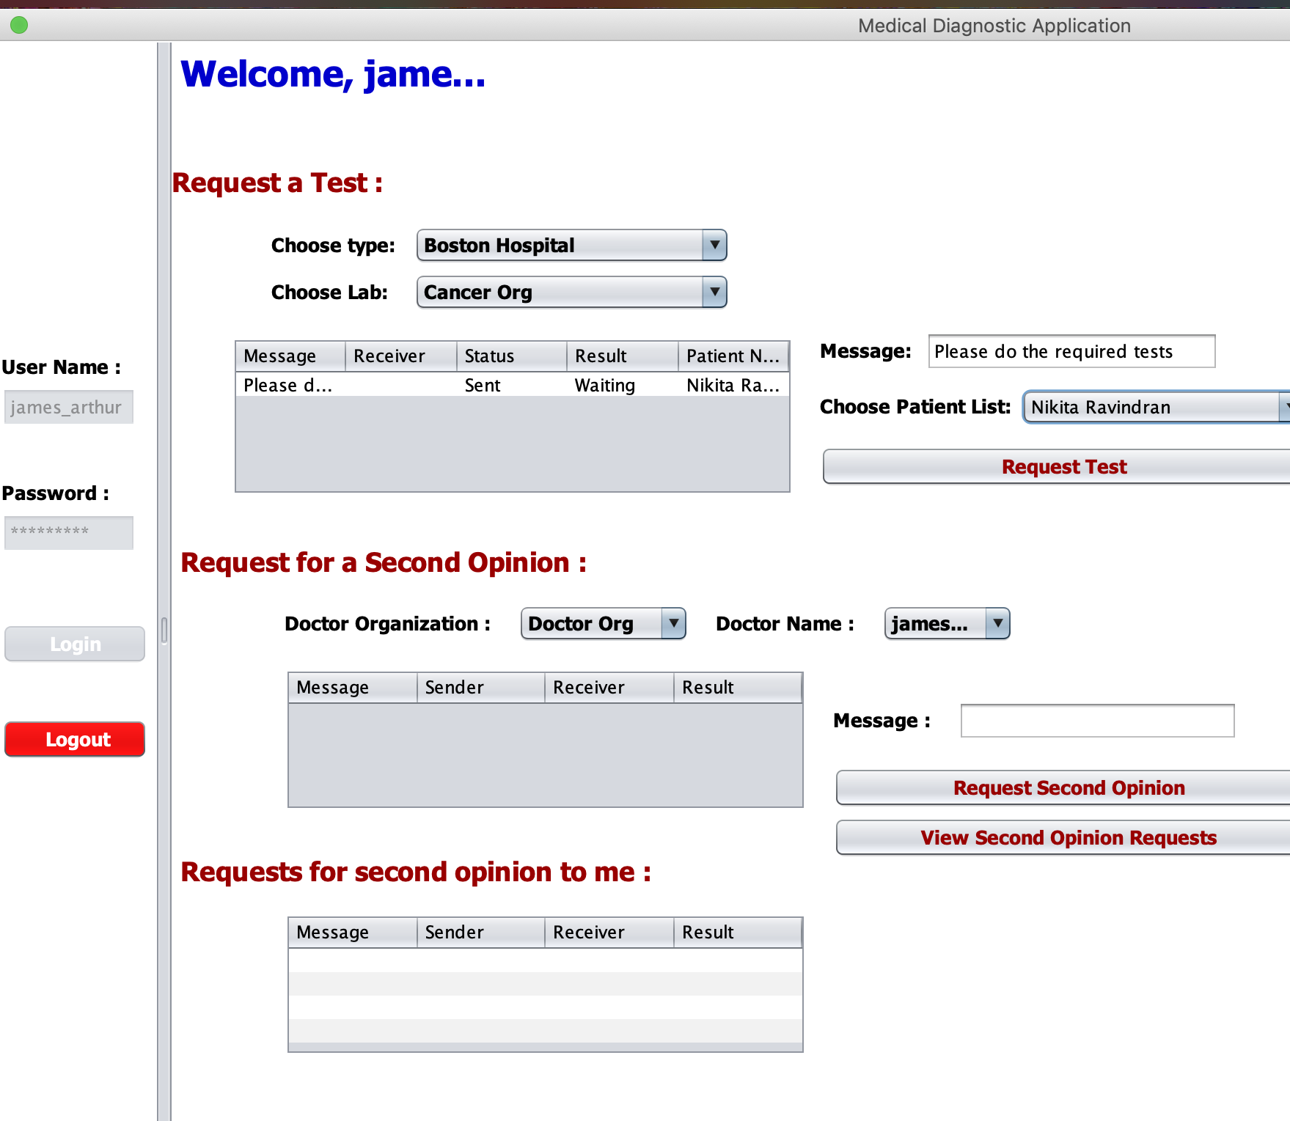
Doctors Panel

Slide 7
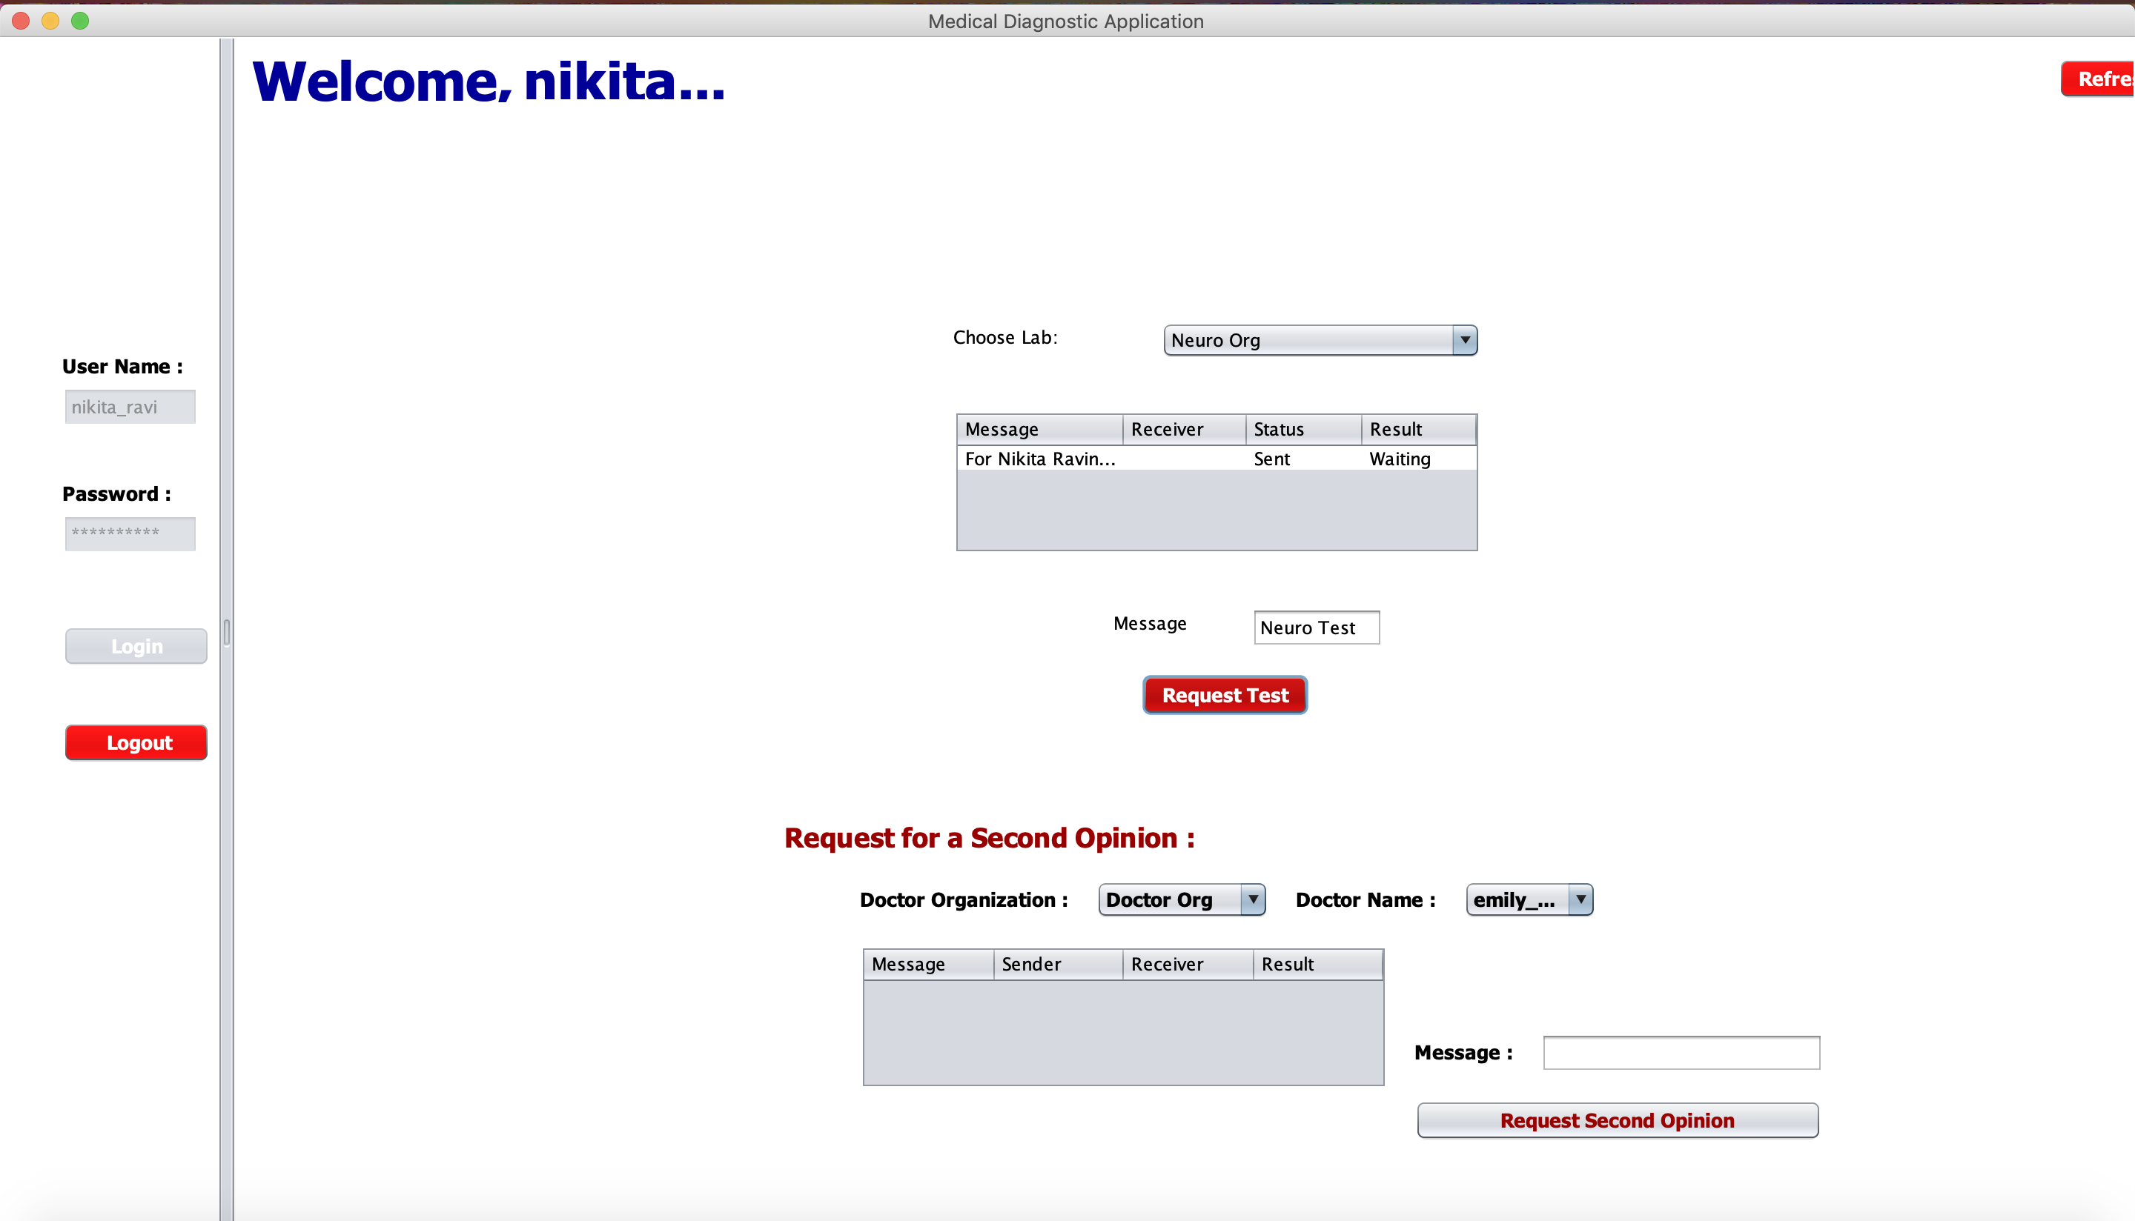
Patients Panel

Slide 8
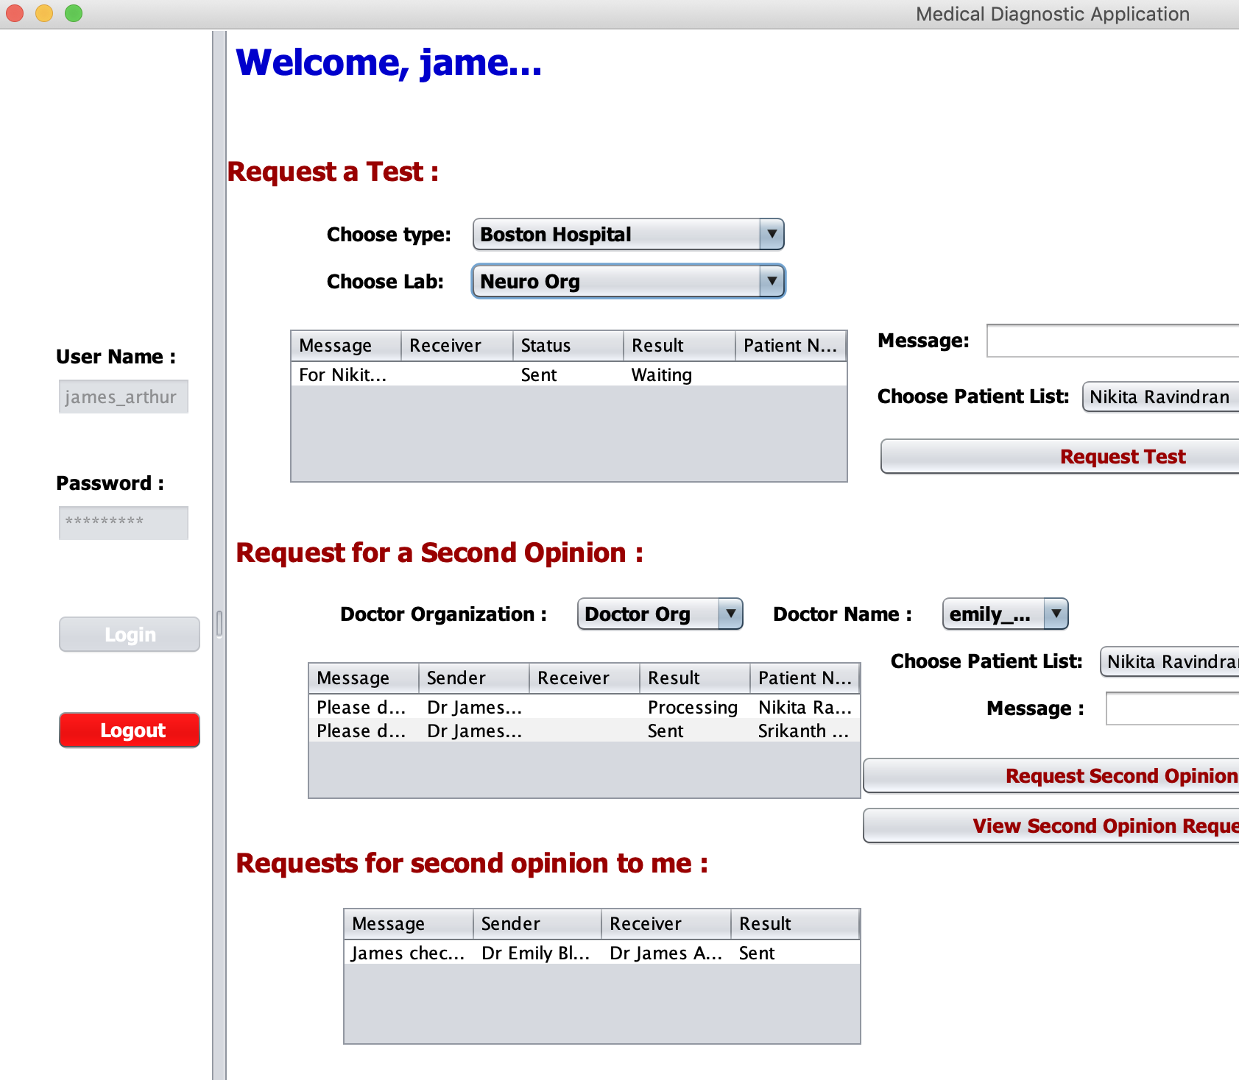
Doctor Request/View Second Opinion

Slide 9
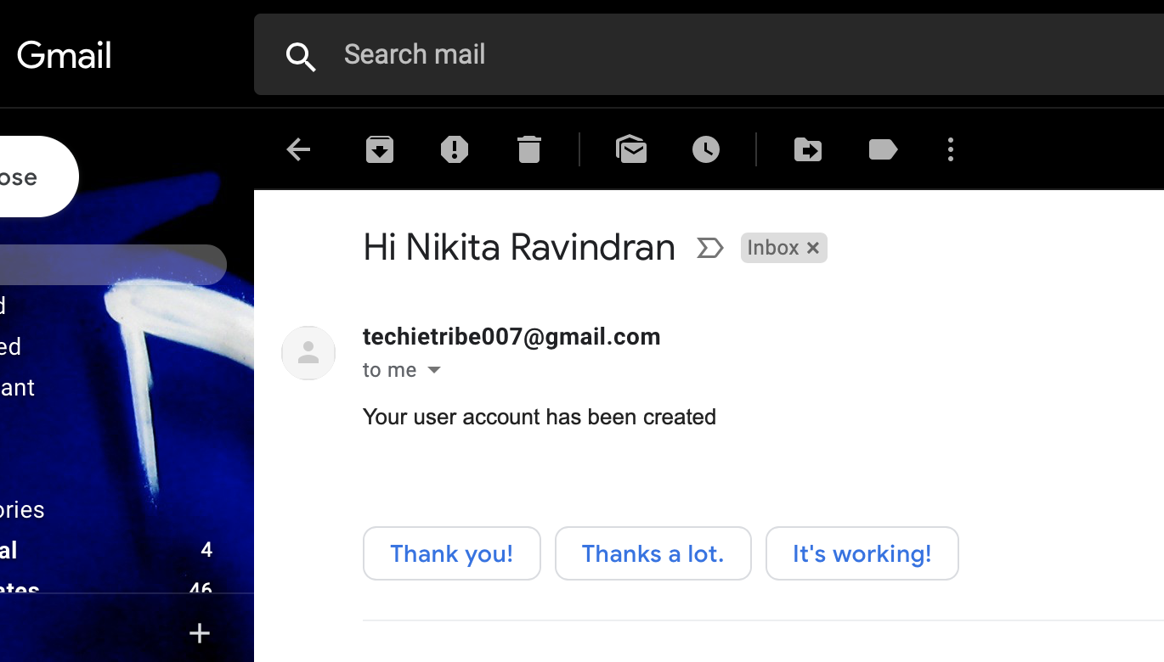
Patient Account Creation Notification

Slide 10
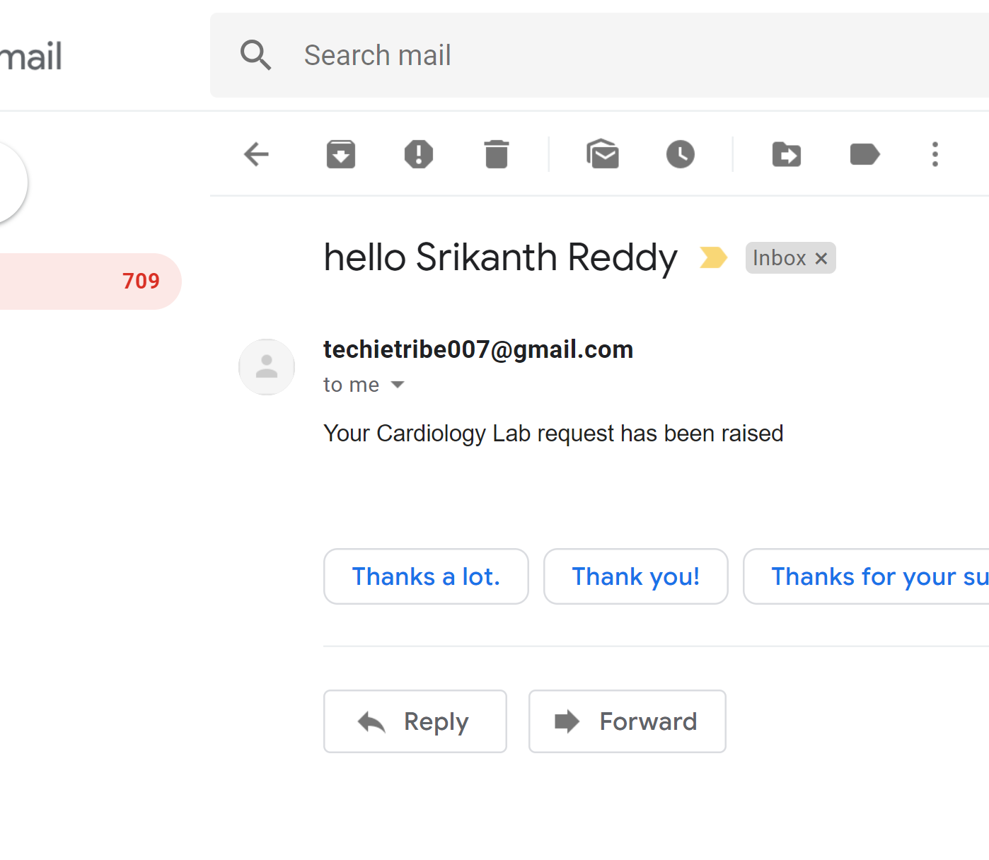
Lab Request Creation Notification to Patient

Slide 11
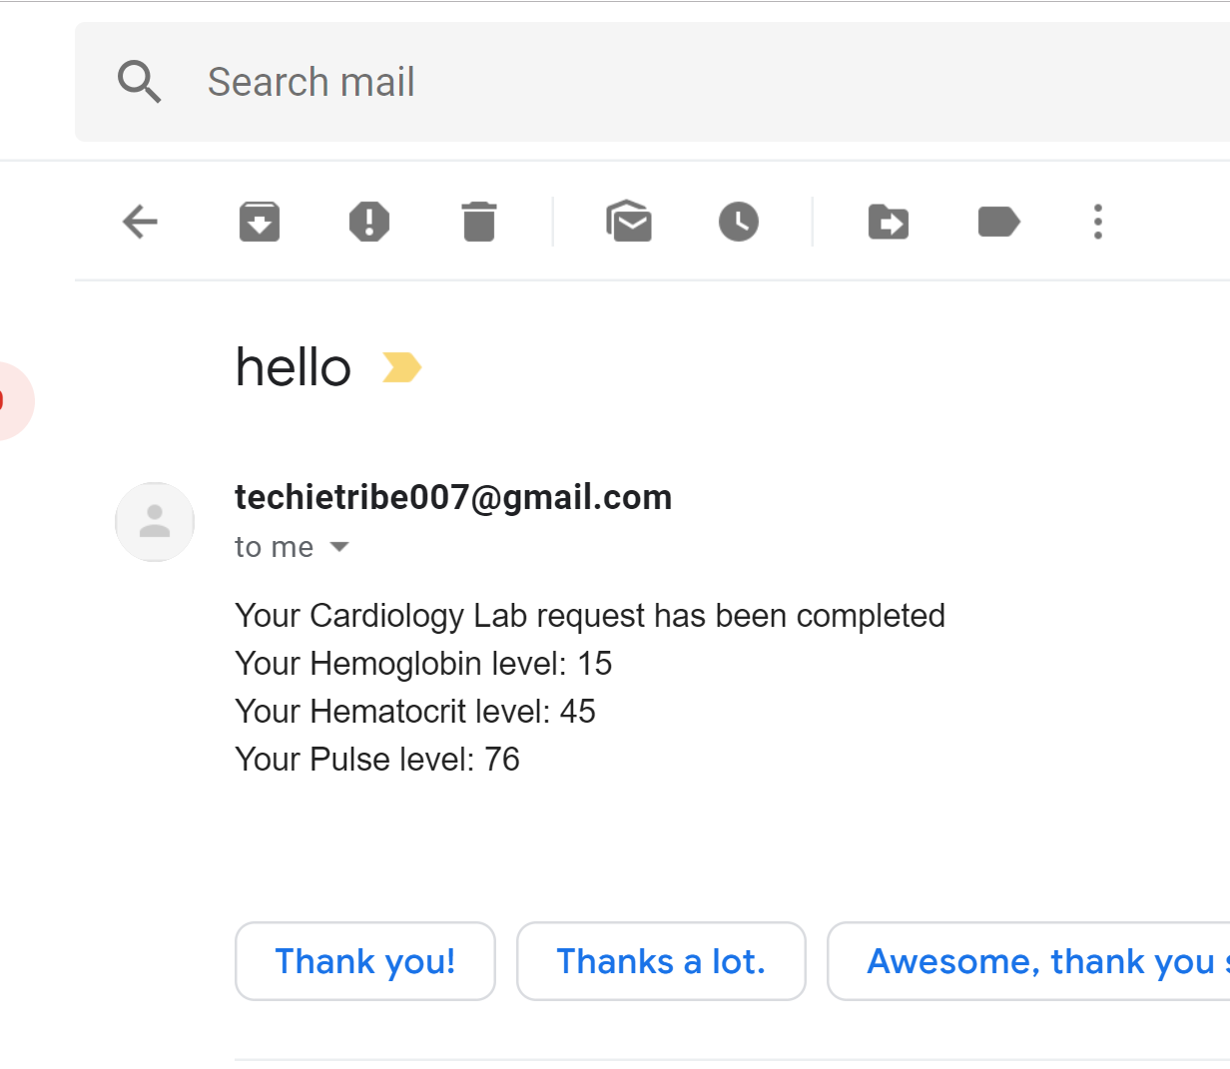
Lab Result Notification to Patient

Slide 12
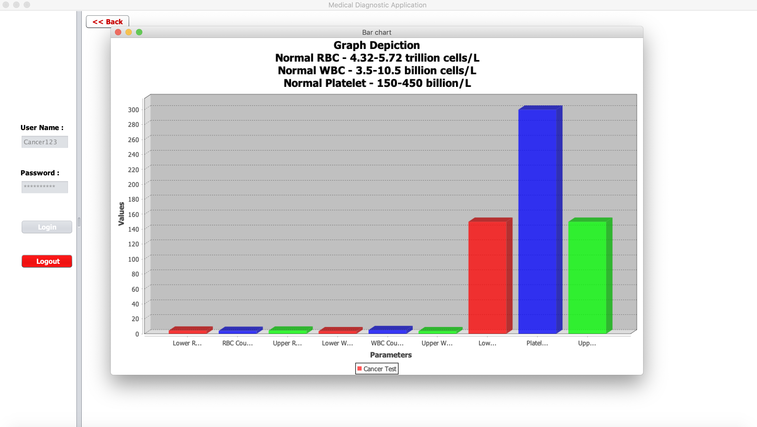
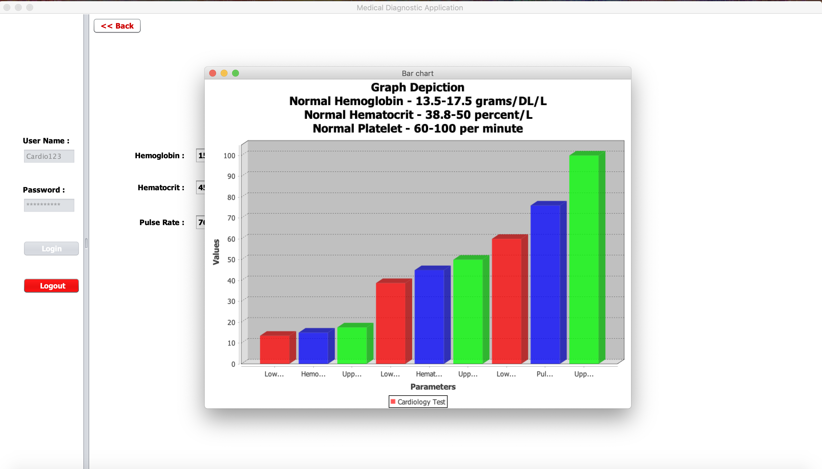
Lab Analysis Reports

Slide 13
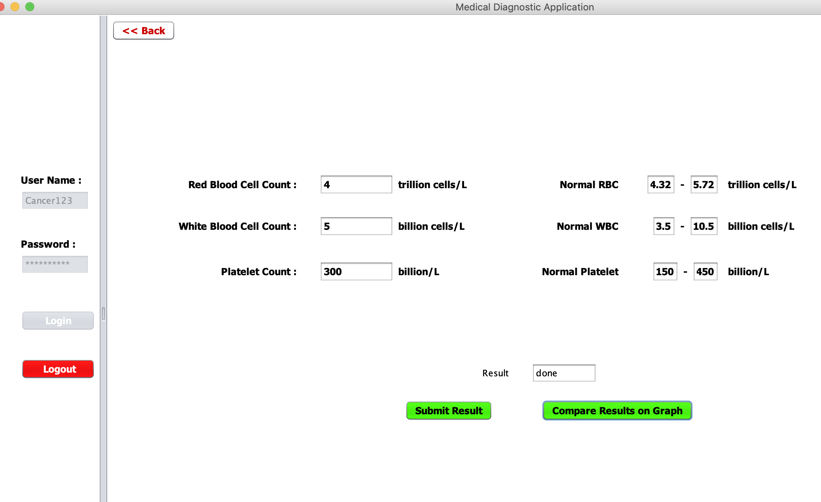
Parameters captured by Lab

Slide 14
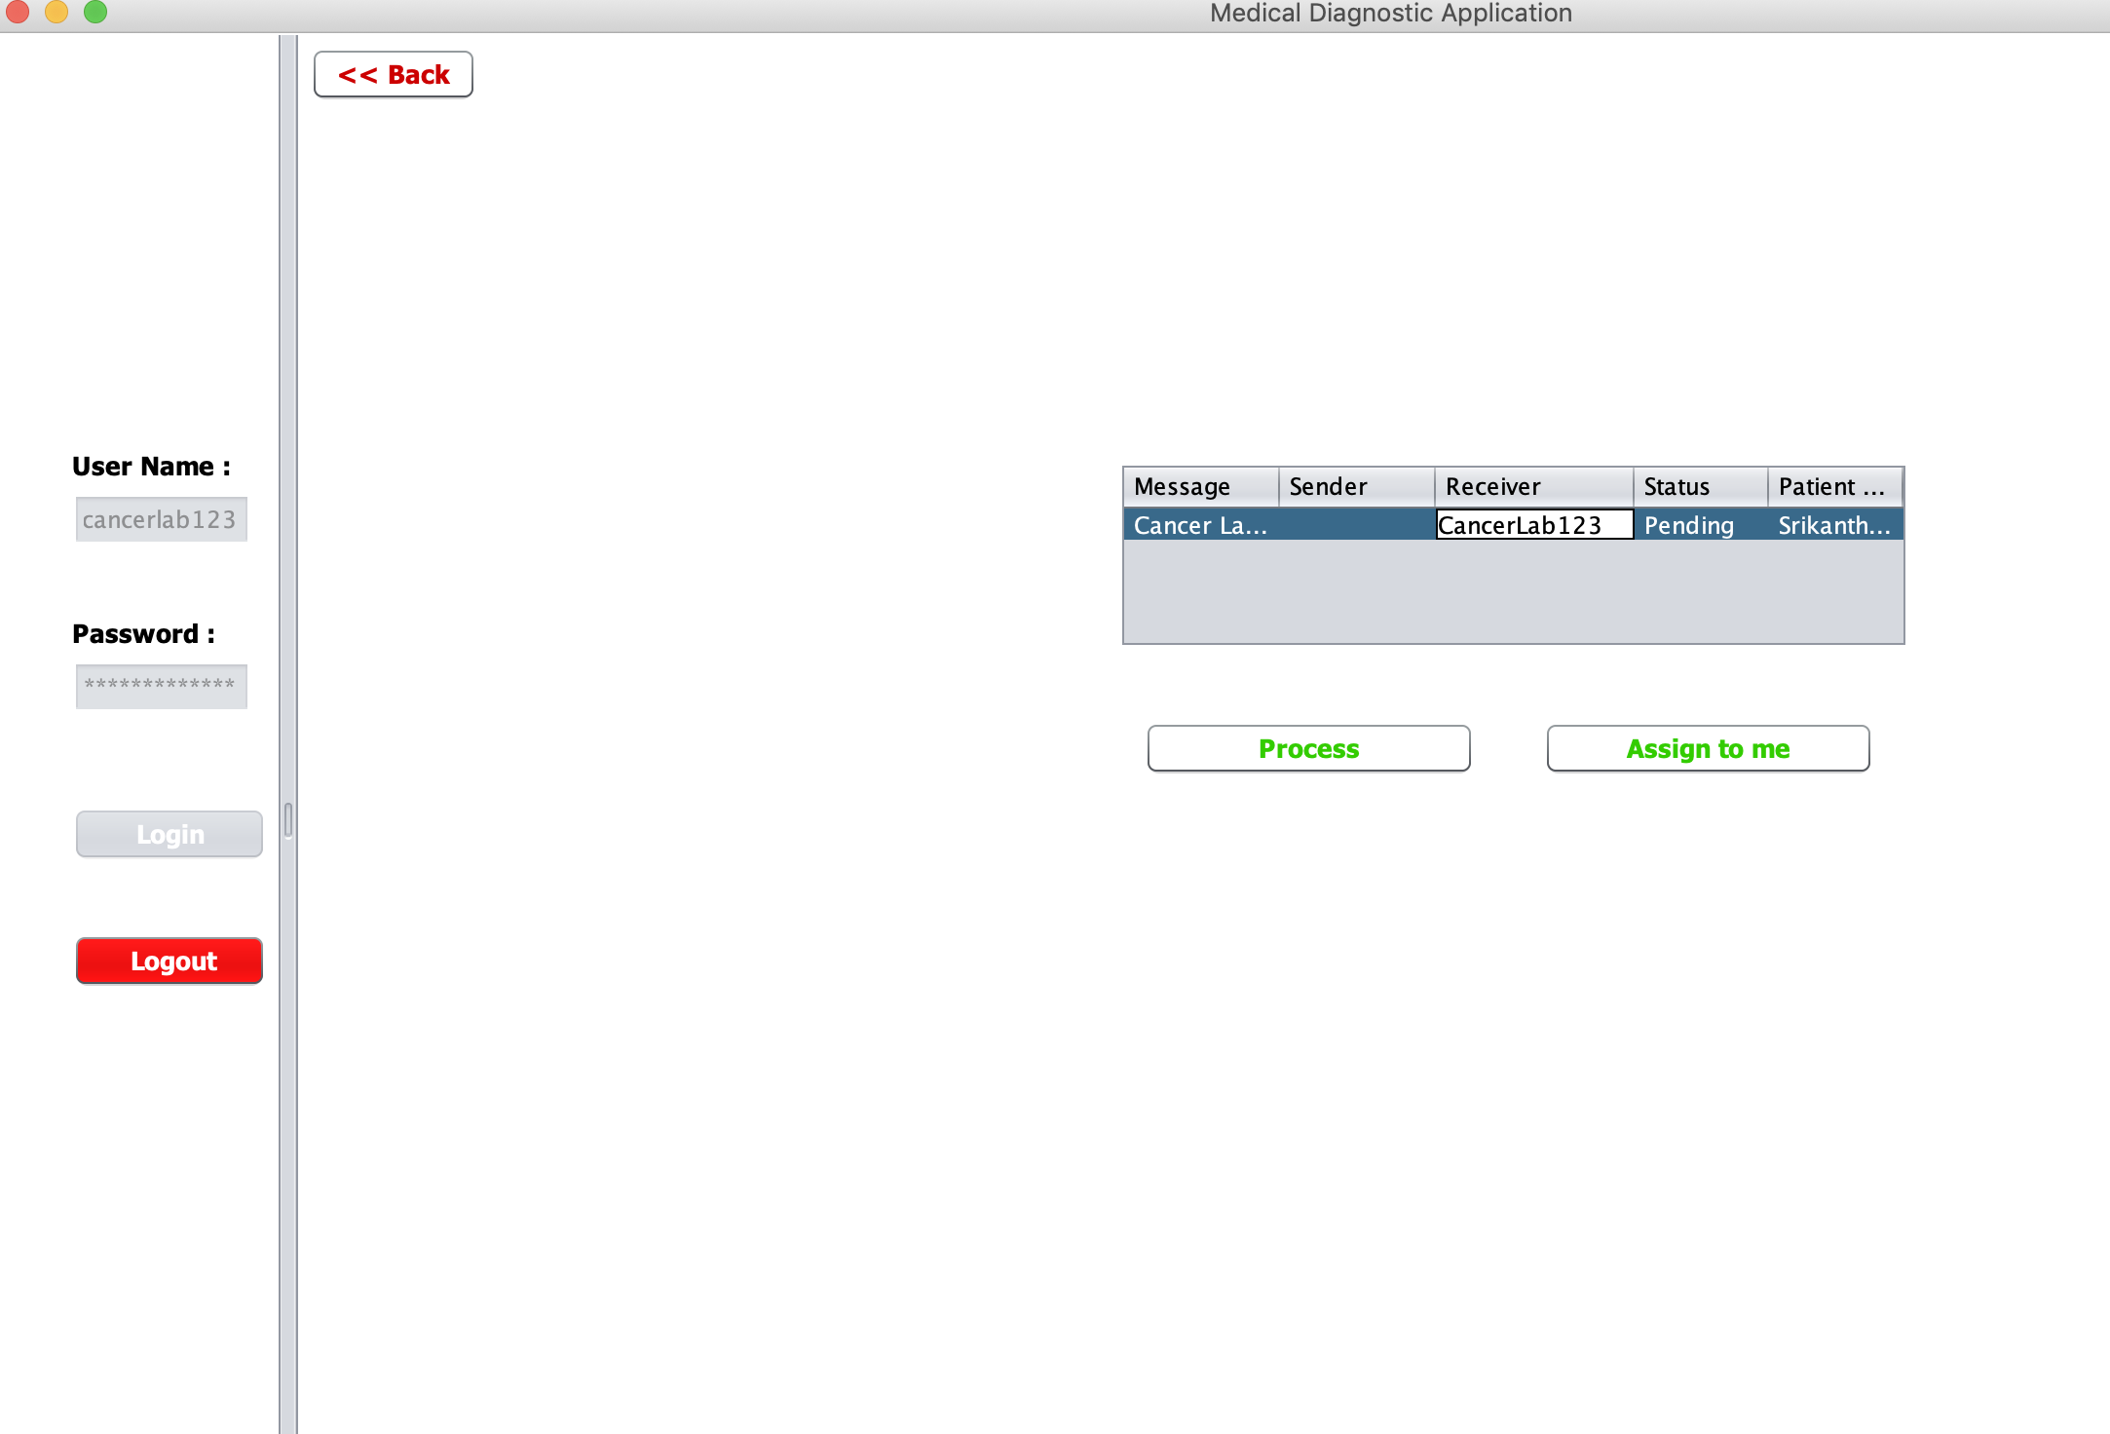
Enterprise to Enterprise & Enterprise to Organization Communication

